Slide 1



RED TEAM CAPSTONE ENGAGEMENT: TRIMENTO BANK SIMULATION
From Reconnaissance to Full Domain Compromise

Slide 2


ENGAGEMENT OVERVIEW
Objective:
Simulate a real-world cyberattack to identify vulnerabilities in Trimento Bank’s infrastructure and validate defensive capabilities.
Scope:
Targets: Public-facing web servers, VPN gateways, internal AD domains (CORP, ROOT, BANK), SWIFT banking systems.
Final Objective: Unauthorized $10M funds transfer via SWIFT portal.
Key Outcomes:
Full compromise of corporate and financial domains
Critical gaps: Weak passwords, misconfigured services, lack of MFA, and role separation failures.
PAGE 1

Slide 3
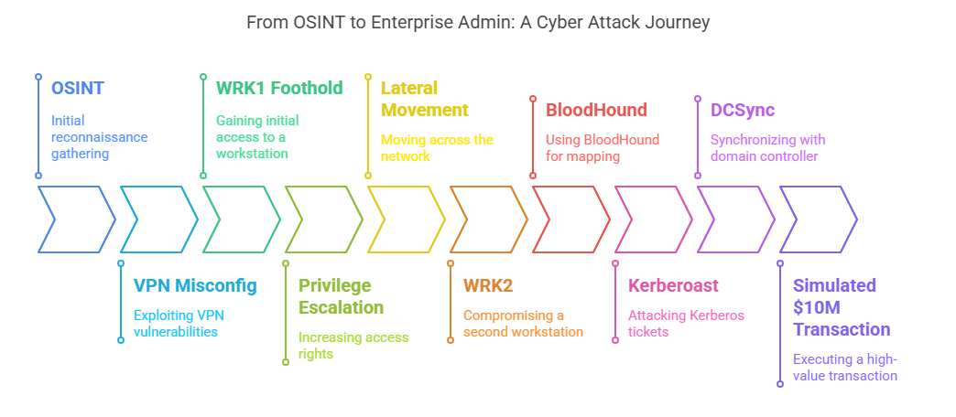
HIGH-LEVEL ATTACK FLOW DIAGRAM
PAGE 2

Slide 4
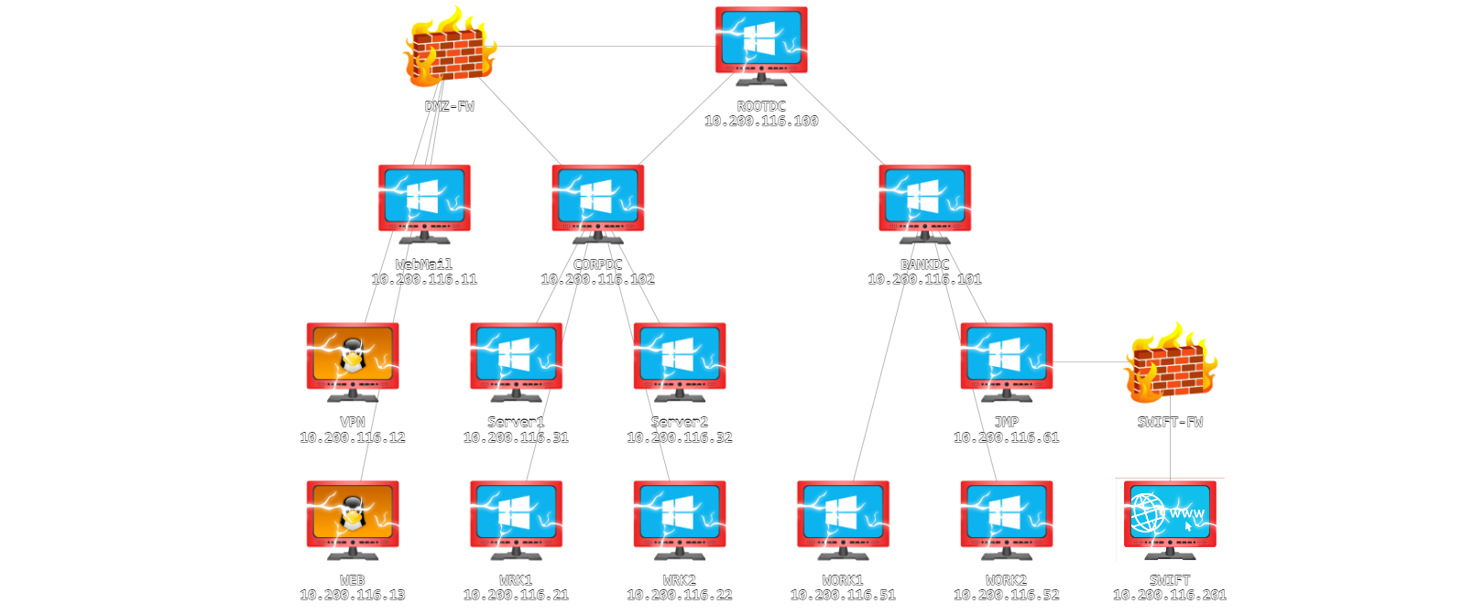
Network Diagram After Full Compromise
PAGE 3

Slide 5


PHASE-BY-PHASE KILL CHAIN SUMMARY
Reconnaissance
Techniques: OSINT, directory enumeration (e.g., /vpn exposed .ovpn file).
Impact: Enabled credential spraying and VPN access.
Initial Access
Techniques: Brute-forcing RDP/VPN (e.g., Password1@ for laura.wood).
Impact: User-level access to WRK1/WRK2.
PAGE 4

Slide 6
PHASE-BY-PHASE KILL CHAIN SUMMARY
Privilege Escalation
Techniques: Sudo misconfiguration (/bin/cp to overwrite /etc/passwd), Kerberoasting (svcScanning:Password1!).
Impact: SYSTEM/root access.
Domain Compromise
Techniques: DCSync abuse (svcBackups account), Golden Ticket forgery.
Impact: Enterprise Admin privileges.
PAGE 5

Slide 7
PHASE-BY-PHASE KILL CHAIN SUMMARY
SWIFT Exploitation
Techniques: Browser-stored credentials, Weak separation of roles. (g.watson, a.holt).
Impact: $10M fraudulent transaction.
PAGE 6

Slide 8
KEY FINDINGS (RISK-BASED)
Finding | Risk Level | Proof | Remediation | MITRE ATT&CK
Exposed OpenVPN Config File | Critical | Screenshot of .ovpn download | Restrict VPN access + MFA | T1190
Sudo Misconfiguration (/bin/cp) | Critical | Terminal output showing root access | Audit sudoers; apply least privilege | T1548
KRBTGT Hash Extraction | Critical | Mimikatz DCSync output | Rotate KRBTGT biannually | T1003.001
SWIFT Role Compromise | Critical | Screenshot of approved $10M transaction | Enforce MFA; separate roles | T1557
PAGE 7

Slide 9


TOOL STACK
1.
RECON
Nmap, ffuf, OSINT frameworks.
2.
EXPLOITATION
Hydra, Impacket, Evil-WinRM.
3.
POST-EXPLOITATION
BloodHound, Mimikatz, Chisel
PAGE 8

Slide 10
TECHNIQUES (MITRE ATT&CK)
1.
T1110 – PASSWORD SPRAYING
2.
T1558 – GOLDEN TICKET
3.
T1059 – COMMAND INJECTION
4.
T1098 – ACCOUNT MANIPULATION
5.
T1003 – CREDENTIAL DUMPING
6.
T1075 – PASS-THE-HASH
PAGE 9

Slide 11

DATA COLLECTED
1.
CREDENTIALS
15+ accounts (e.g., svcBackups:q9nzssaFtGHdqUV3Qv6G).
2.
HASHES
KRBTGT, Administrator NTLM.
2.
NETWORK MAPS
AD trust relationships (CORP ↔ ROOT ↔ BANK).
PAGE 10

Slide 12

DEFENSE-IN-DEPTH ROADMAP
Immediate (0–30d): Patch VPN, rotate KRBTGT, disable SMBv1.
Short-Term (30–90d): Deploy EDR/XDR; enforce MFA globally.
Long-Term (90d+): Redesign network with micro-segmentation.
PAGE 11

Slide 13


STRATEGIC RECOMMENDATIONS
Segment Critical Systems: Isolate SWIFT from general AD.
Adopt Zero Trust: Enforce MFA for VPN/RDP and privileged accounts.
Conduct Quarterly Purple Teaming: Simulate advanced threats.
PAGE 12

Slide 14

TACTICAL RECOMMENDATIONS
(BLUE TEAM)
Monitor DCSync Activity: Alert on Get-ADReplAccount usage.
Harden Service Accounts: Enforce LAPS; remove unnecessary SPNs.
Audit Sudo Rules: Restrict non-admin privileges.
PAGE 13

Slide 15

THANK YOU
RED-RECON FORCES
PAGE 14

